Slide 1
Introduction to Image Processing
Lecture-1 (17th August 2021)

Slide 2
Lectures:
Tues: 9:30am to 11am
Thurs: 9:30am to 11am
Grading scheme:
Item | Weightage
Midterm | 25%
Endterm | 35%
Quiz | 20%
Matlab Task | 10%
Project | 10%

Slide 3
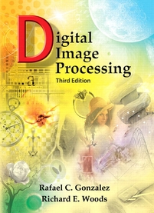
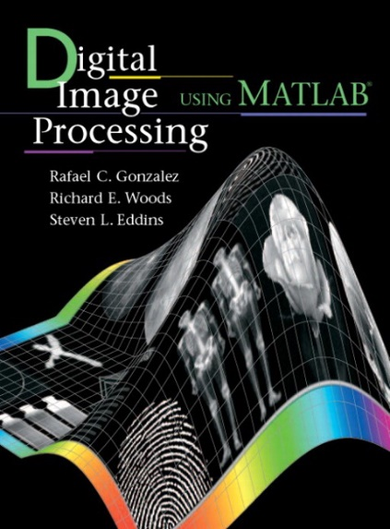
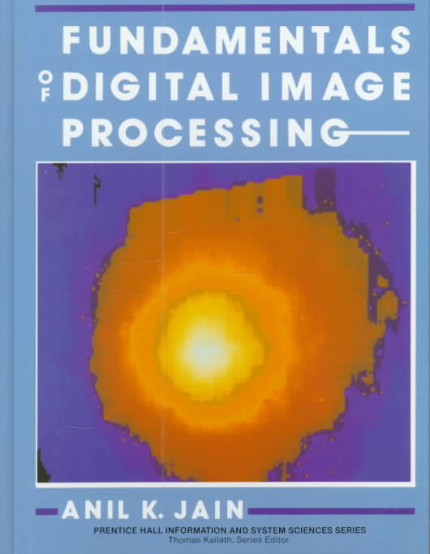
Textbooks
Digital Image Processing
Rafael C. Gonzalez and Richard E. Woods,
Pearson Education, 3rd edition
--------------------------------------
Fundamentals of Digital Image Processing
Anil K. Jain
Prentice Hall, 2009
--------------------------------------

Slide 4
Projects
List of projects at Stanford (https://web.stanford.edu/class/ee368/Project_Winter_1819/index.html)
Projects at MIT Media Lab
SixthSense
Panoramic Image stitching, activity recognition (2).
Image Inpainting
Biometrics
Face detection/recognition, smile detection, image morphing, signature verification, number plate recognition, identifying the book, gesture recognition, text recognition, gesture recognition, traffic monitoring.

Slide 5
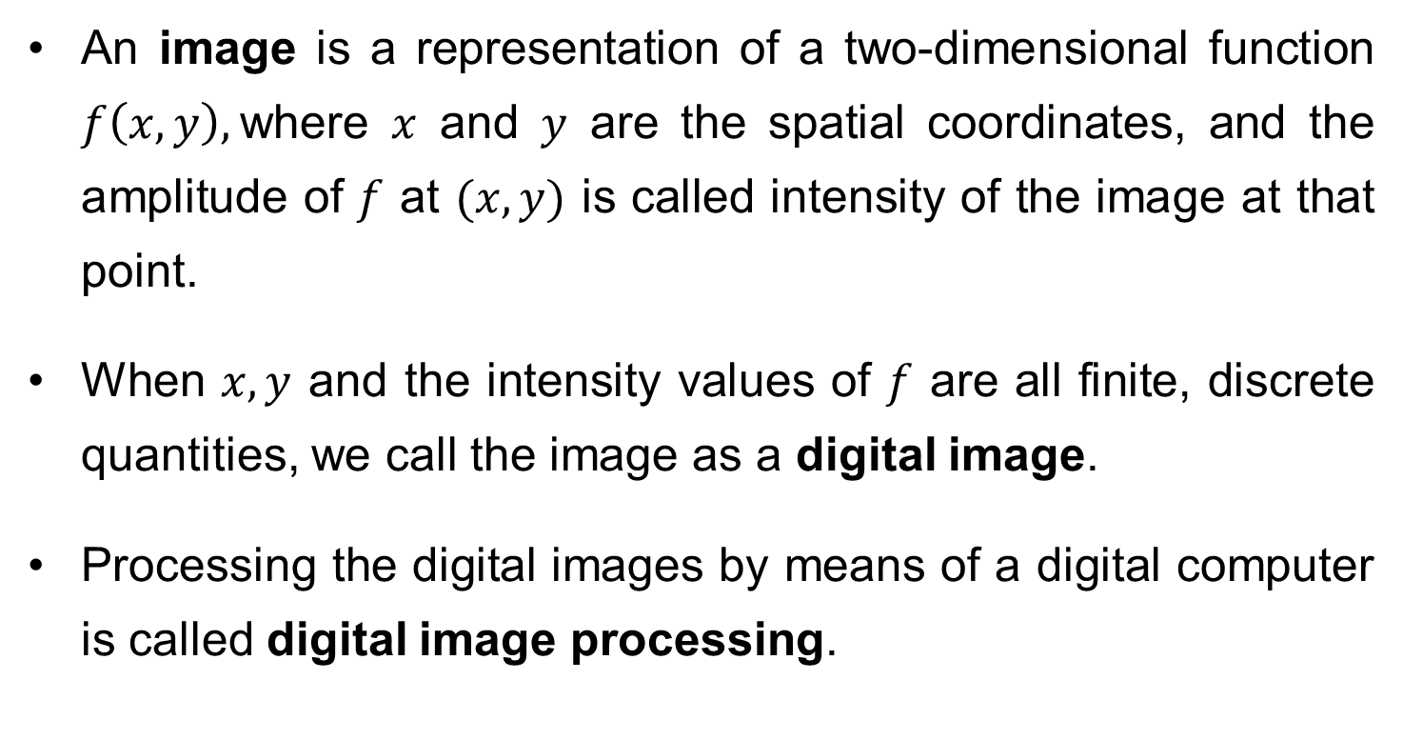
What is a Digital Image?
An image is a representation of a two-dimensional function $f\left(x,y\right),$where $x$ and $y$ are the spatial coordinates, and the amplitude of $f$ at $(x,y)$ is called intensity of the image at that point.
When $x, y$ and the intensity values of $f$ are all finite, discrete quantities, we call the image as a digital image.
Processing the digital images by means of a digital computer is called digital image processing.

Slide 6

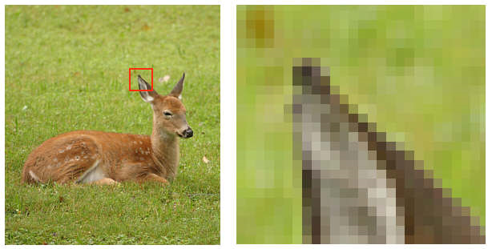
cont…
A digital image is composed of finite number of elements, each having location and value. These elements are called pixels/picture elements.
1 pixel

Slide 7
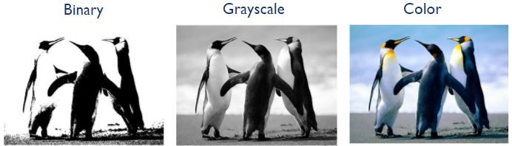
cont…
Common image formats include:
1 sample per point (B&W/binary, Grayscale)
3 samples per point (Red, Green, and Blue)

Slide 8
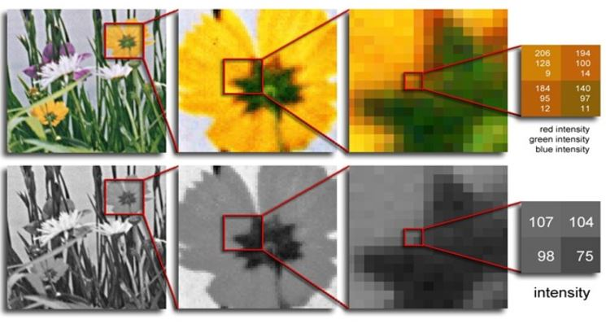
cont…

Slide 9
Key Stages in Digital Image Processing
Image Restoration
Morphological Processing
Image Enhancement
Segmentation
Image Acquisition
Representation & Description
Object Recognition
Problem Domain
Colour Image Processing
Image Compression

Slide 10

Image Acquisition
Image Restoration
Morphological Processing
Image Enhancement
Segmentation
Image Acquisition
Representation & Description
Object Recognition
Problem Domain
Colour Image Processing
Image Compression

Slide 11
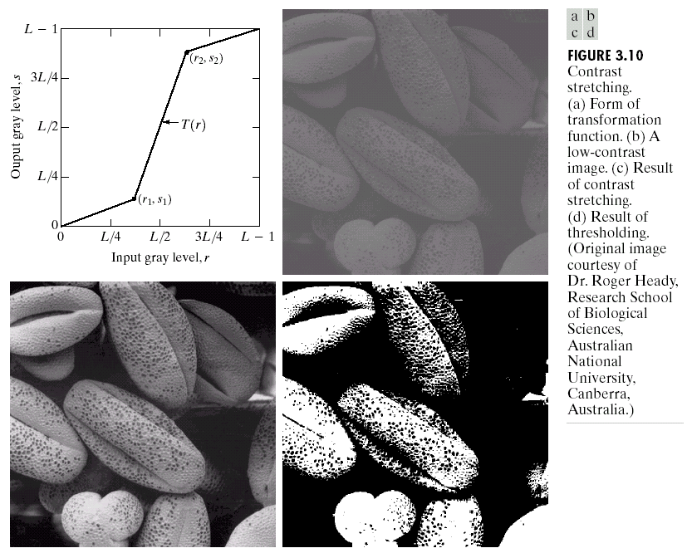
Image Enhancement
Image Restoration
Morphological Processing
Image Enhancement
Segmentation
Image Acquisition
Representation & Description
Object Recognition
Problem Domain
Colour Image Processing
Image Compression

Slide 12
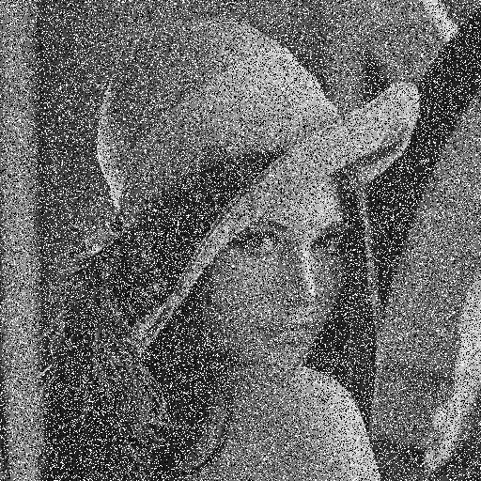
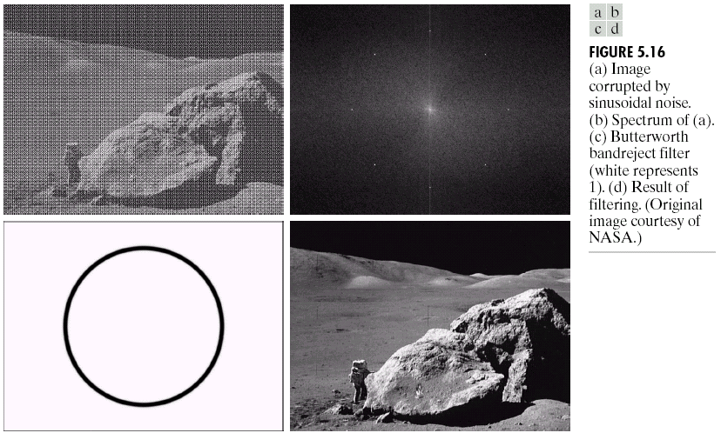
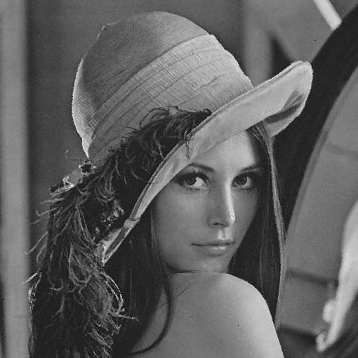
Image Restoration
Image Restoration
Morphological Processing
Image Enhancement
Segmentation
Image Acquisition
Representation & Description
Object Recognition
Problem Domain
Colour Image Processing
Image Compression

Slide 13


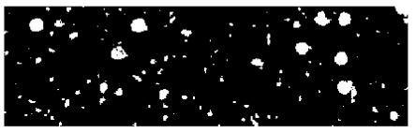
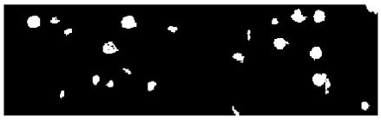
Morphological Processing
Image Restoration
Morphological Processing
Image Enhancement
Segmentation
Image Acquisition
Representation & Description
Object Recognition
Problem Domain
Colour Image Processing
Image Compression

Slide 14
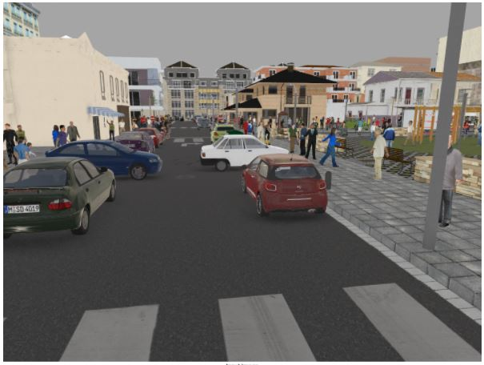
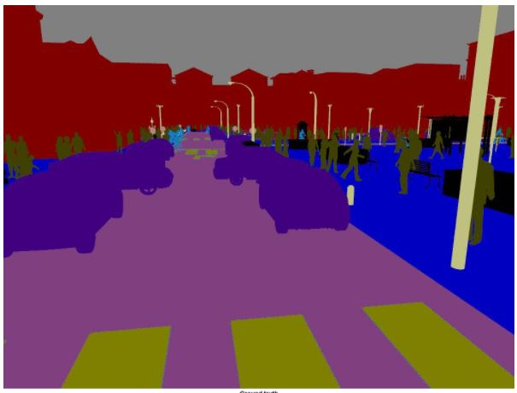
Segmentation
Image Restoration
Morphological Processing
Image Enhancement
Segmentation
Image Acquisition
Representation & Description
Object Recognition
Problem Domain
Colour Image Processing
Image Compression

Slide 15
Representation & Description
Image Restoration
Morphological Processing
Image Enhancement
Segmentation
Image Acquisition
Representation & Description
Object Recognition
Problem Domain
Colour Image Processing
Image Compression

Slide 16
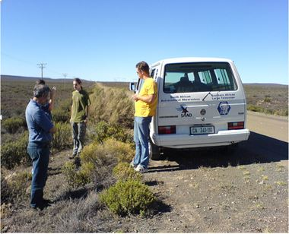
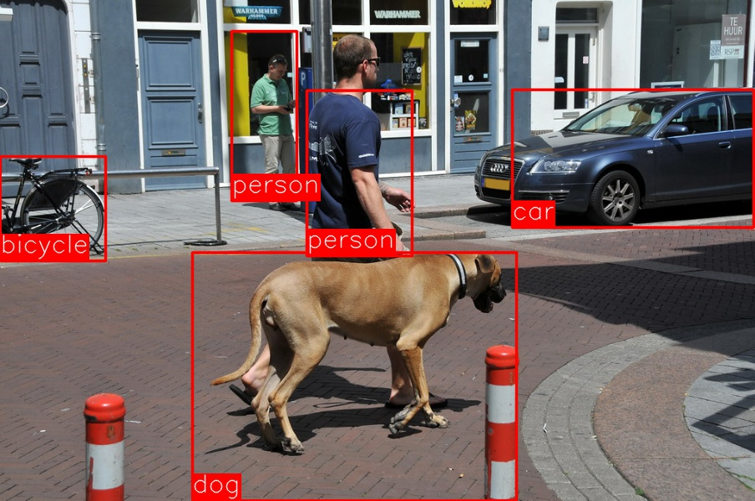
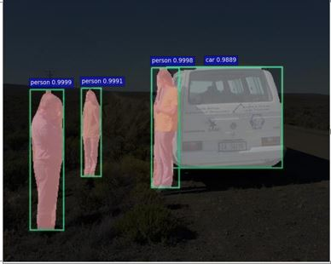
Object Recognition
Image Restoration
Morphological Processing
Image Enhancement
Segmentation
Image Acquisition
Representation & Description
Object Recognition
Problem Domain
Colour Image Processing
Image Compression

Slide 17
Topics to be covered in next class
Image acquisition
Image formation model
Image sampling and quantization
Representing digital images

Slide 18
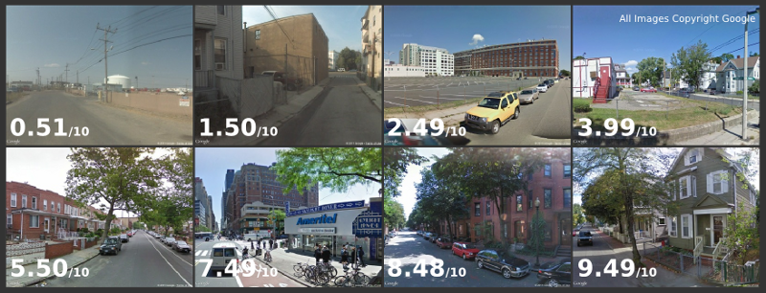
2014-15 Streetscore
The typical high scoring image contains suburban houses with manicured lawns and streets lined with trees; while the typical low scoring image contains empty streets, fences, and industrial buildings.

Slide 19
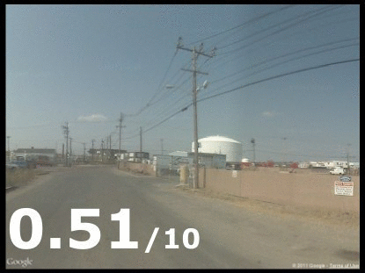

Slide 20
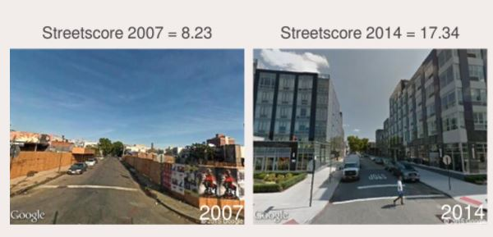
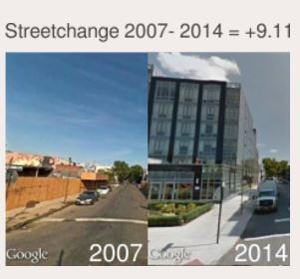
2016-17
Streetchange

Slide 21
https://www.media.mit.edu/projects/seeing-through-walls-computer-vision/overview/
https://www.media.mit.edu/projects/looking-around-corners/overview/
https://www.youtube.com/watch?v=JWDocXPy-iQ
https://www.media.mit.edu/

Slide 22
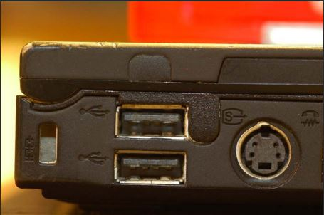
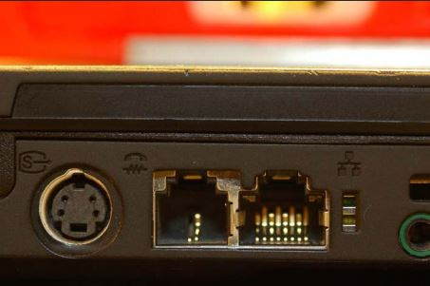
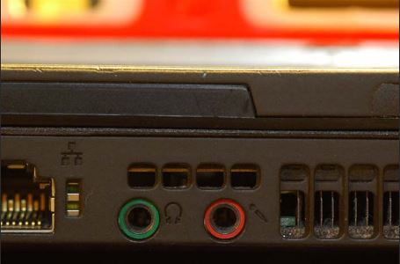
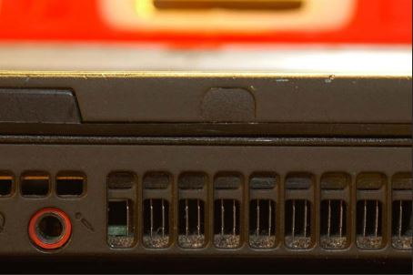
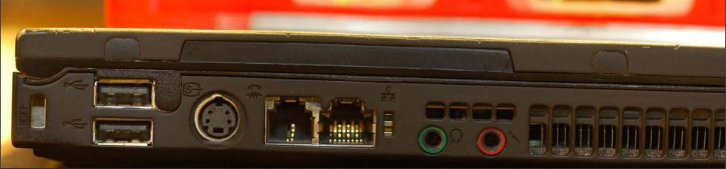

Slide 23
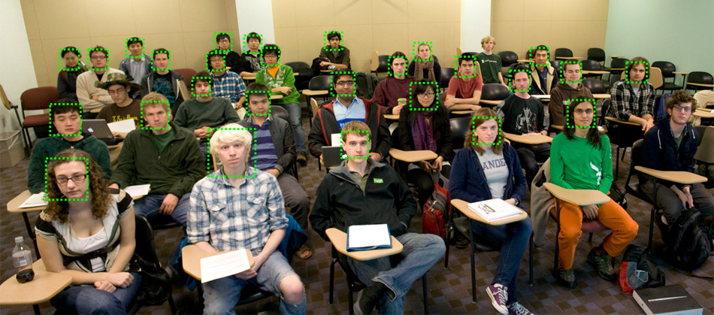
Face detection in a classroom

Slide 24
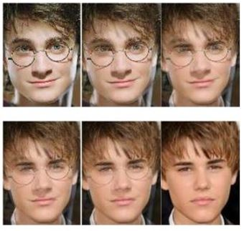
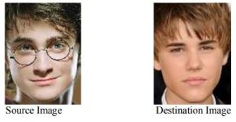
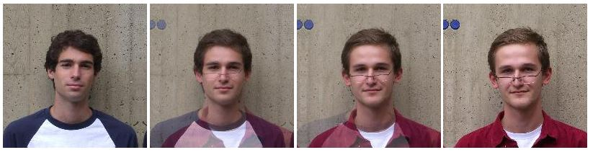
Image morphing

Slide 25
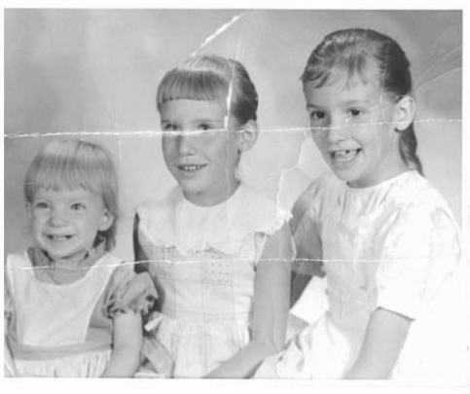

Image Inpainting 1

Slide 26
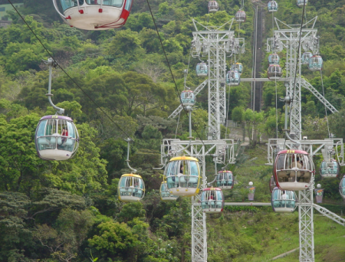
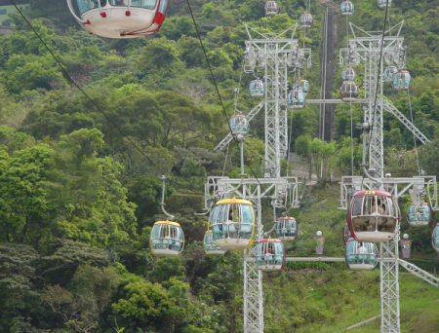
Image Inpainting 2

Slide 27
Smile detection

Slide 28
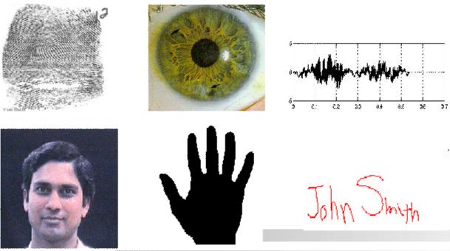
Biometrics

Slide 29
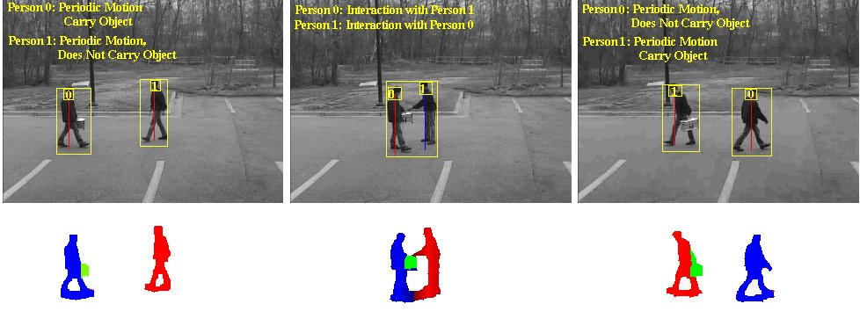
Activity recognition

Slide 30
